Slide 1
Operating Systems
Security
Again:
Liu Fagui

Slide 2
Content of this lecture
Review
The security environment
Operating system security（操作系统安全）
Protection mechanisms (保护机制)
Formal Models of Secure Systems
Basics of cryptography (密码学基础)
User authentication (用户验证)
Software vulnerabilities(软件漏洞）
Attacks from inside the system(内部攻击)
Malware(恶意软件)
Defense（防御）
Summary

Slide 3
Review
Disks
Clocks
用户界面：键盘、鼠标和监视器
  输入软件
  输出软件
    Character-oriented terminals
    Graphical user interfaces
    Network terminals
Power management

Slide 4
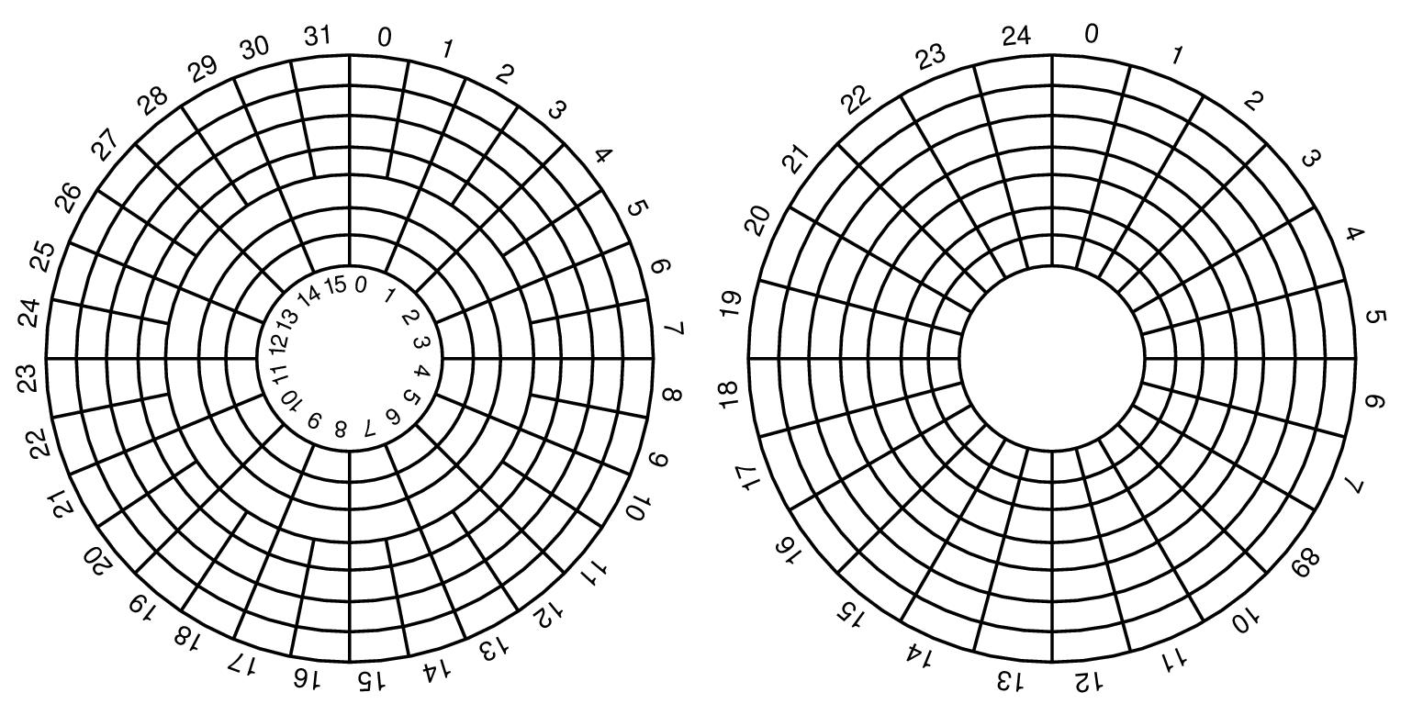
Disk Hardware (2)
(a) Physical geometry of a disk with two zones(两环带)
(b) A possible virtual geometry for this disk (a). 扇区数都是192
地址：（x柱面,y磁头,z扇区）->实际的柱面、磁头和扇区
<number>/66

Slide 5


Disk Formatting (1)
A disk sector（一个磁盘扇区）
Preamble前导码(识别扇区的开始、包含柱面与扇区号及其他信息） Data数据 （其大小由低级格式化程序决定，大多数磁盘使用512字节的扇区）
ECC包含冗余信息，可以用来恢复读错误。其域的大小与内容随生产商的不同而不同。
低级格式化。
<number>/66

Slide 6
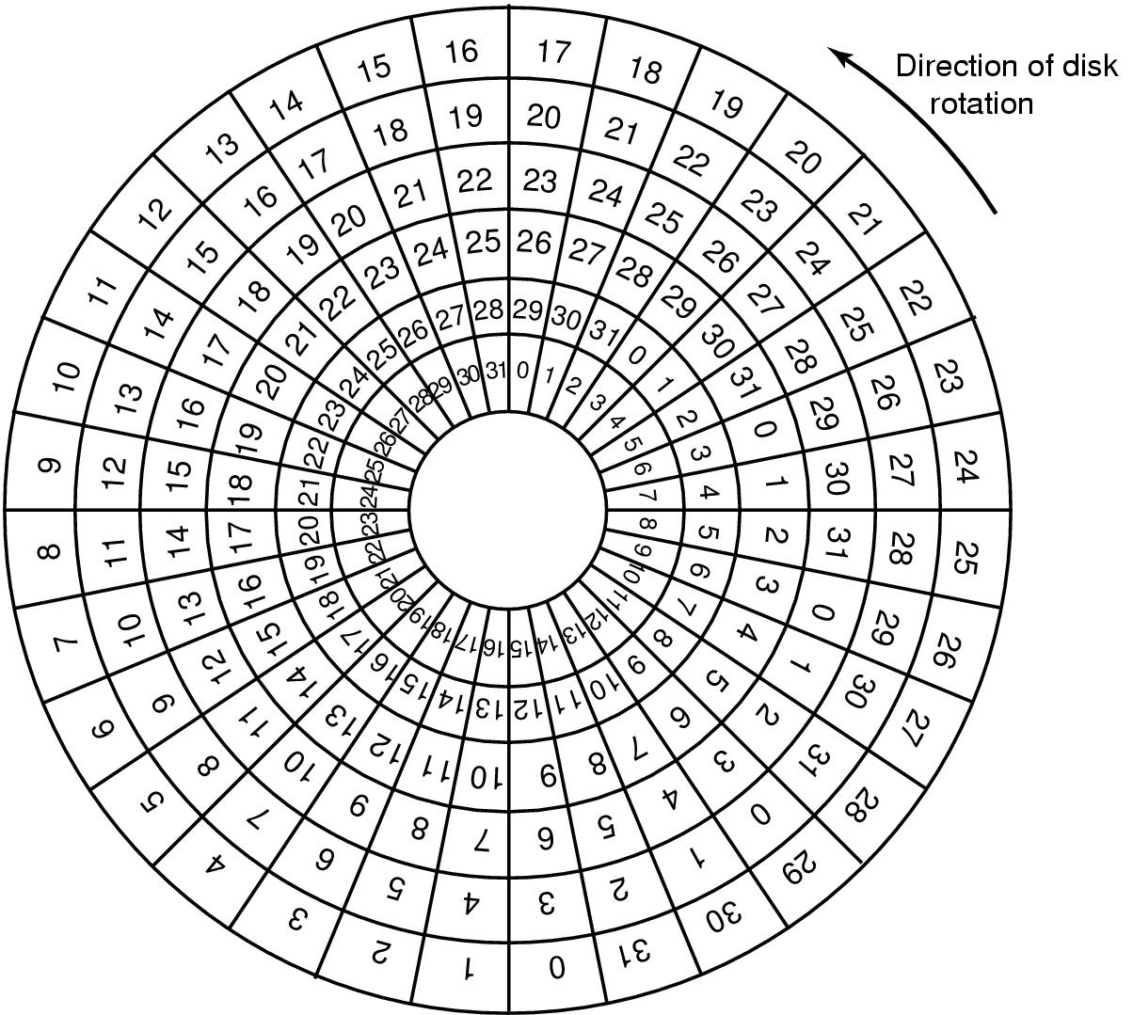




Disk Formatting (2)
An illustration of cylinder skew(柱面斜进的示意图)
（柱面斜进量（每个磁道上第0扇区的位置与前一磁道存在偏移）
取决驱动器的几何规格）
<number>/66

Slide 7
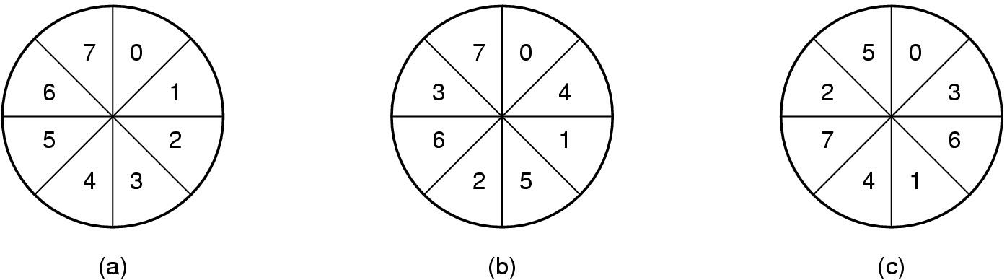
















Disk Formatting (3)
No interleaving Single interleaving Double interleaving
（非交错） （单交错） （双交错）
低级格式化后，对磁盘分区（对多个操作系统共存是必须的），对每个分区高级格式化（设置引导块、空闲存储管理、根目录、一个空文件系统)。
启动：BIOS运行-〉主引导记录MBR-〉执行活动分区第一块(引导块)-〉OS
<number>/66

Slide 8


Disk Arm Scheduling Algorithms (1)
Time required to read or write a disk block determined by 3 factors
  Seek time (the time to move the arm to the proper cylinder).
  Rotational delay (the time for the proper sector to rotate under the head).
  Actual transfer time
Seek time dominates
Error checking is done by controllers
<number>/66

Slide 9
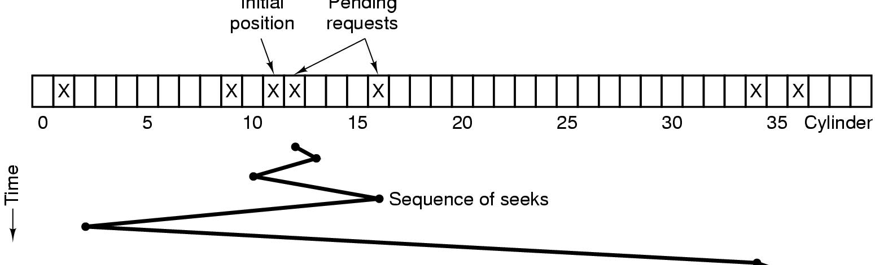





Disk Arm Scheduling Algorithms (2)
Initial
position
Pending
requests
如请求为：1,36,16,34,9,12.（FCFS顺序,移动磁道数为111）
SSF访问顺序（公平，但缺乏效率）（如图）为12，9，16，1，34，36。
Shortest Seek First (最短寻道时间优先SSF) disk scheduling algorithm（获得最小相应时间，但缺乏公平）
移动磁道数为1，3，7，15，33，2，共61个柱面。
<number>/66

Slide 10
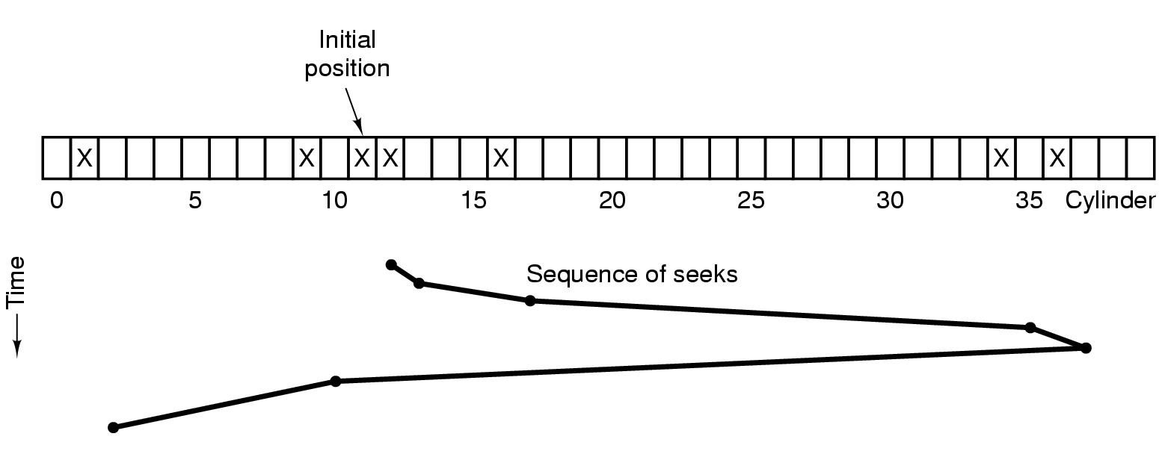

Disk Arm Scheduling Algorithms (3)
访问顺序为12，16，34，36，9，1。
The elevator algorithm（电梯算法、Scan扫描算法） for scheduling disk requests（兼顾效率和公平性）
移动磁道数为1，4，18，2，27，8，共60个柱面。
<number>/66

Slide 11
Clocks—又称为定时器（timer）
Clock Hardware时钟硬件----所做的工作是根据已知的时间间隔产生中断。
两种类型的时钟：
  简单时钟: 连接在110V或220V的电源线上，每个电压周期产生一个中断，频率为50Hz或60Hz。现少见。
  可编程时钟：由三个部件组成：晶体振荡器、计数器（在每一个脉冲递减）、存储寄存器（用于加载计数器）。给计算机的各种电路提供同步信号，该信号被送到计数器，使其递减计数至0。当计数器为0时，产生一个CPU中断。
<number>/76

Slide 12
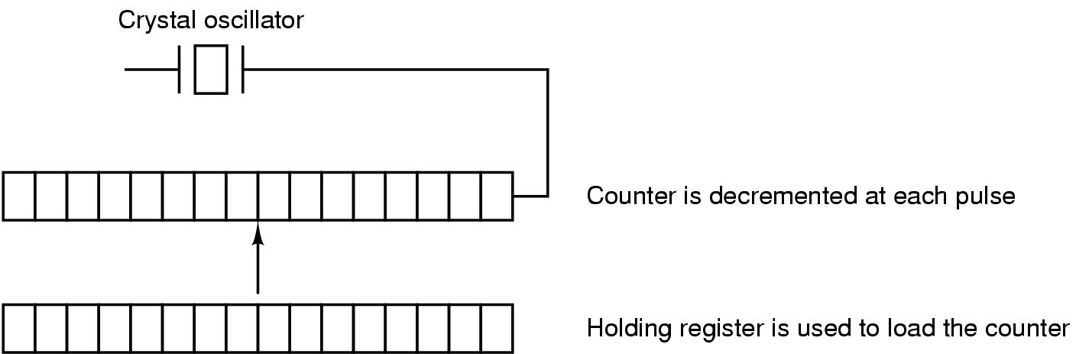

A programmable clock可编程时钟
晶体振荡器
计数器在每一个脉冲递减
存储寄存器用于加载计数器
可编程时钟
A programmable clock可编程时钟（中断频率可由软件控制）----“one-shot mode一次完成模式：当时钟启动时，将存储寄存器的值复制到计算器中，然后来自晶体的每一个脉冲使计算器减1.当计算器变为0时，产生一个中断，并停止工作，直到软件再一次显式地启动它”；“squre-wave mode方波模式：当计算器变为0并且产生中断后，存储寄存器的值自动复制到计算器中，并且整个过程无限期地再次重复下去。”这些周期性的中断称为时钟滴答（Clock tick）
大多数计算机具有一个由电池供电的备份时钟，来保持当前时间。
<number>/76

Slide 13

Clock Software—clock driver
时钟硬件所做的全部工作就是根据已知的时间间隔产生中断。涉及时间的其他所有工作由软件完成。
The exact duties of the clock driver:
  Maintaining the time of day(维护日时间）.
  Preventing processes from running longer than they are allowed to.(防止进程超时运行）
  Accounting for CPU usage.（CPU记账）
  Handling the alarm system call made by user processes.（处理用户提出的alarm系统调用）
  Providing watchdog timers for parts of the system itself.（监视定时器）
  Doing profiling, monitoring, and statistics gathering. （完成剖析、监控、统计信息收集）

Slide 14
Soft Timers(软定时器（1）--辅助可编程时钟）
A second clock available for timer interrupts
  specified by applications
  no problems if interrupt frequency is low
Soft timers avoid interrupts（避免中断）
  kernel checks for soft timer expiration（期满） before it exits to user mode
  how well this works depends on rate of kernel entries（进入内核的频率）
<number>/66

Slide 15

Soft Timers（软定时器(2)）
Soft timers succeed according to rate at which kernel entries are made because of(软定时器随着因其他原因进入内核的频率而脉动，这些原因有）:
System calls.
TLB misses.
Page faults.
I/O interrupts.
The CPU going idle.

Slide 16
Input Software
Keyboard driver delivers a number
  driver converts to characters
  uses a ASCII table
Exceptions, adaptations needed for other languages
  many OS provide for loadable keymaps（键盘映射） or code pages（代码页）
处理方法：面向字符、面向行的
<number>/66

Slide 17
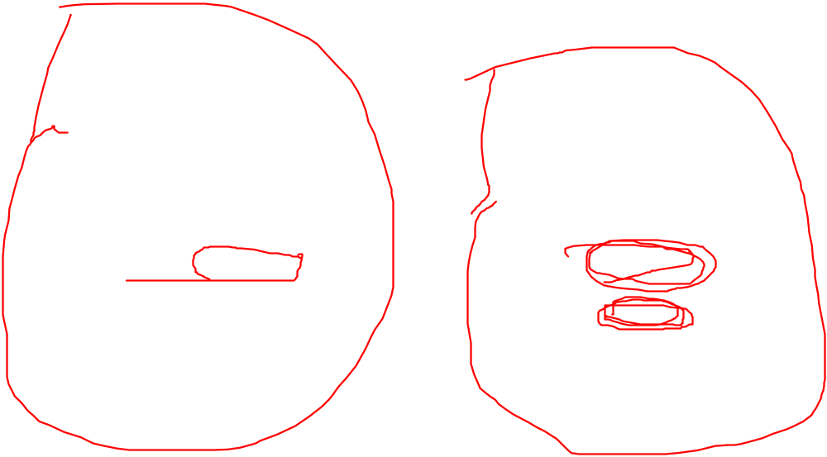
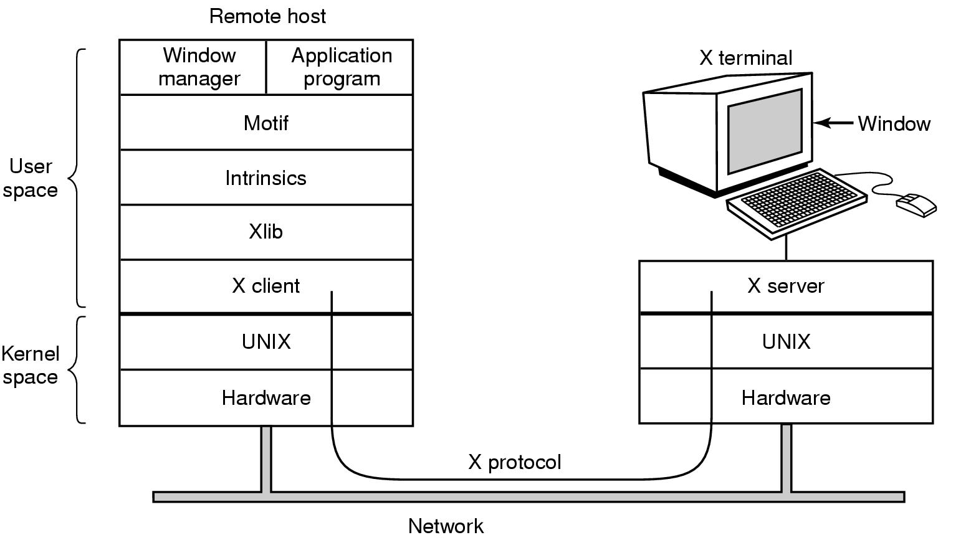
X Windows
Clients and servers in the MIT X Window System
<number>/77

Slide 18

The X Window System
Types of messages between client and server:
Drawing commands from the program to the workstation.
Replies by the workstation to program queries.
Keyboard, mouse, and other event announcements.
Error messages.

Slide 19
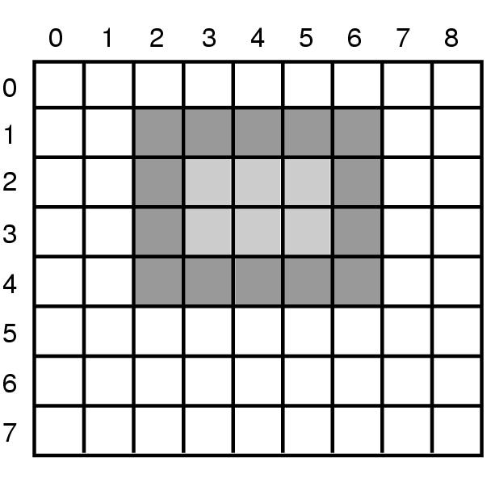

GUI--Output Software for Windows (4)
（Graphics Device Interface）GDI是矢量图形学的实例。用于在屏幕上放置几何图形和文本。它们相对设备无关。
An example rectangle drawn using Rectangle
Rectangle(hdc,2,1,6,4)
<number>/66

Slide 20
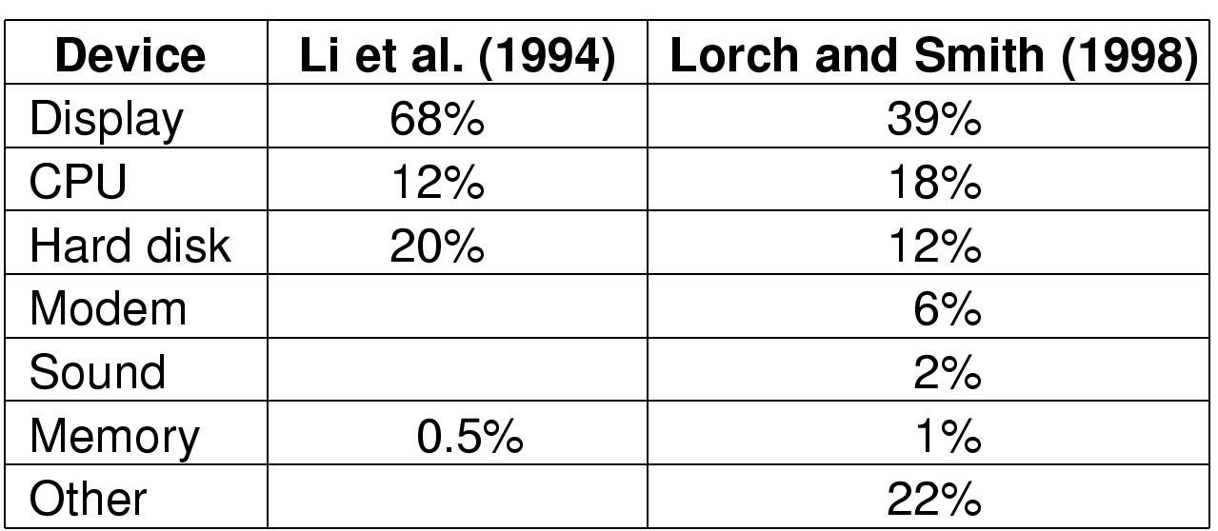
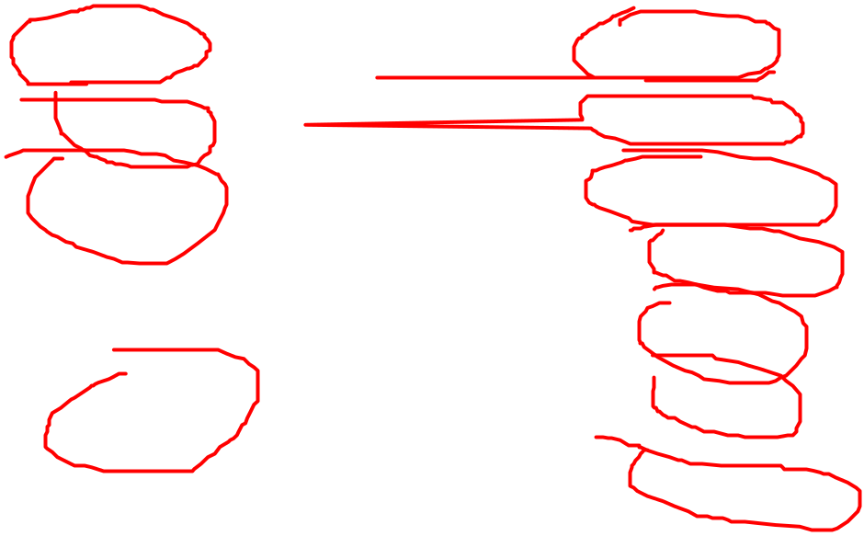
Power Management (1)
Power consumption of various parts of a laptop computer
CPU、内存、I/O设备被设计成：工作、睡眠、休眠、关闭等状态

Slide 21
Content of this lecture
Review
The security environment
Operating system security（操作系统安全）
Protection mechanisms (保护机制)
Formal Models of Secure Systems
Basics of cryptography (密码学基础)
User authentication (用户验证)
Software vulnerabilities(软件漏洞）
Attacks from inside the system(内部攻击)
Malware(恶意软件)
Defense（防御）
Summary

Slide 22
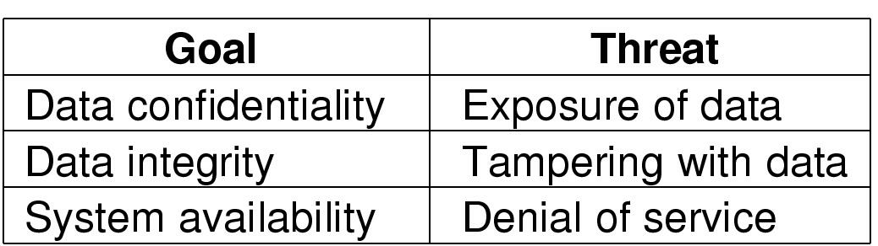
The Security Environment
----Threats(威胁)
Security goals (机密性、完整性、可用性)
Threats(威胁:数据暴露,数据篡改,拒绝服务)

Slide 23
The Security Environment ---Intruders(入侵者)
Common Categories
Casual prying by nontechnical users(非专业用户的随意浏览)
Snooping by insiders(内部人员的窥视)
Determined attempt to make money(为获取利益的尝试)
Commercial or military espionage(商业或军事间谍)

Slide 24
The Security Environment --Accidental Data Loss(数据意外遗失)
Common Causes
Acts of God (天灾)
  fires, floods, wars
Hardware or software errors(软硬件错误)
  CPU malfunction, bad disk, program bugs
Human errors(人为过失)
  data entry, wrong tape mounted

Slide 25
Content of this lecture
The security environment
Operating system security（操作系统安全）
Protection mechanisms (保护机制)
Formal Models of Secure Systems
Basics of cryptography (密码学基础)
User authentication (用户验证)
Software vulnerabilities(软件漏洞）
Attacks from inside the system(内部攻击)
Malware(恶意软件)
Defense（防御）
Summary

Slide 26
操作系统安全
我们只关注以操作系统为攻击目标，或者在安全策略执行中操作系统起到重要作用的攻击行为。
加密：将消息或文件进行转码。
程序加固：指对程序中加入保护机制从而使得攻击者很难破坏程序（遵循最小权限规则—--拥有的权限与需要的权限完全一致）。

Slide 27
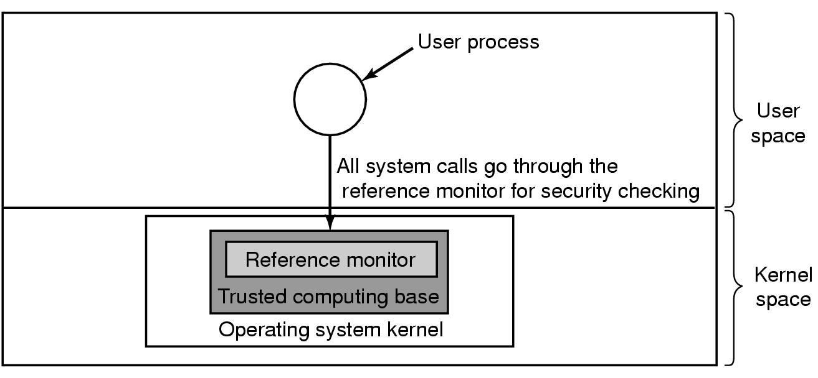
Trusted Systems--Trusted Computing Base(TCB)
A reference monitor(访问监视器)
TCB包含了实施所有安全规则所必需的硬件和软件。
大多数OS不是这样设计的，这也是导致了不安全的部分原因。

Slide 28
Content of this lecture
The security environment
Operating system security（操作系统安全）
Protection mechanisms (保护机制)
Formal Models of Secure Systems
Basics of cryptography (密码学基础)
User authentication (用户验证)
Software vulnerabilities(软件漏洞）
Attacks from inside the system(内部攻击)
Malware(恶意软件)
Defense（防御）
Summary

Slide 29
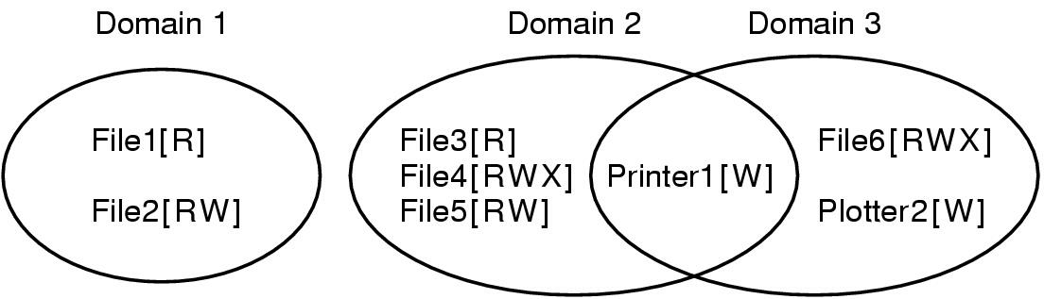
Protection Mechanisms
Protection Domains (1)
Domain 是一对(object, right)组合。每一对组合指定一个对象和一些可在其上运行的操作子集。对象可以是硬件或软件。每个对象都有用于调用其的一系列操作。
任何时间，每个进程会在某个保护域中运行。即进程可以访问某些对象的集合，每个对象都有一个权限集。
Examples of three protection domains
UNIX系统进程的域由UID和GID定义的。

Slide 30
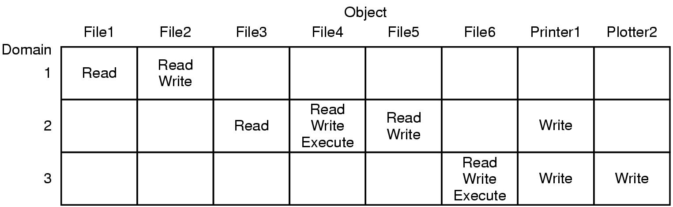
Protection Domains (2)
-- A protection matrix
A protection matrix
用保护矩阵实现从指定的域以特定的方式访问给定的对象
系统如何实现域的自我切换？

Slide 31
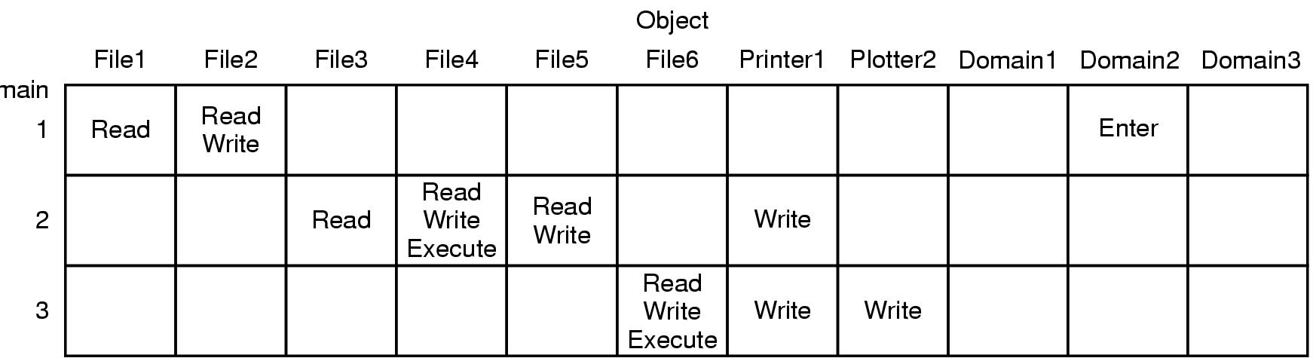
Protection Domains (3)
-- A protection matrix with domains as objects
A protection matrix with domains as objects
域1的进程可以切换到域2中，但是一旦切换后就不能返回。

Slide 32
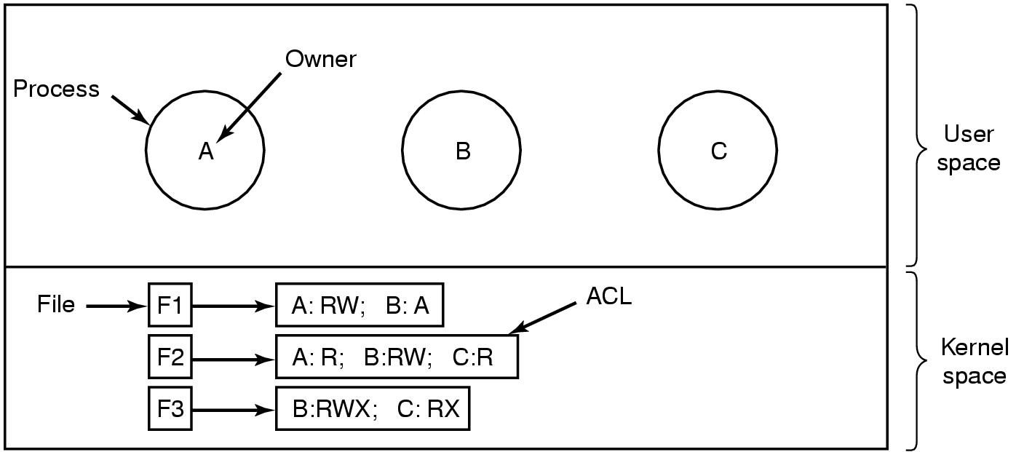
Access Control Lists (1)
实际采用的存放方式（按列存放）
Use of access control lists of manage file access

Slide 33
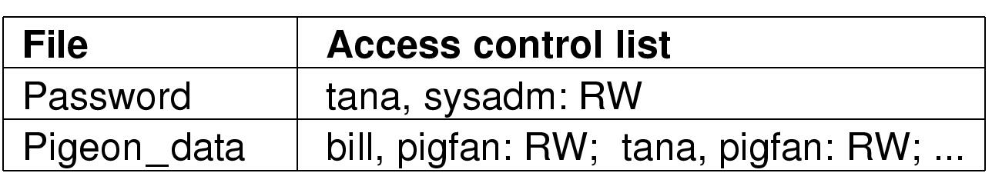
Access Control Lists (2)
访问控制列表
Two access control lists
前页ACL是针对个人用户的。许多系统也支持用户组（group,即引入角色role),组名可以包含在ACL中：
UID1，GID1：rights1; UID12，GID2：rights2;…
  如上图中的tana,属于组sysadm 和pigfan,即两个角色
  Tana,*:RW (定义权限与登录组无关）
  Virgil，*:(none);*,*RW （除Virgil外所有的用户可以读写文件)

Slide 34
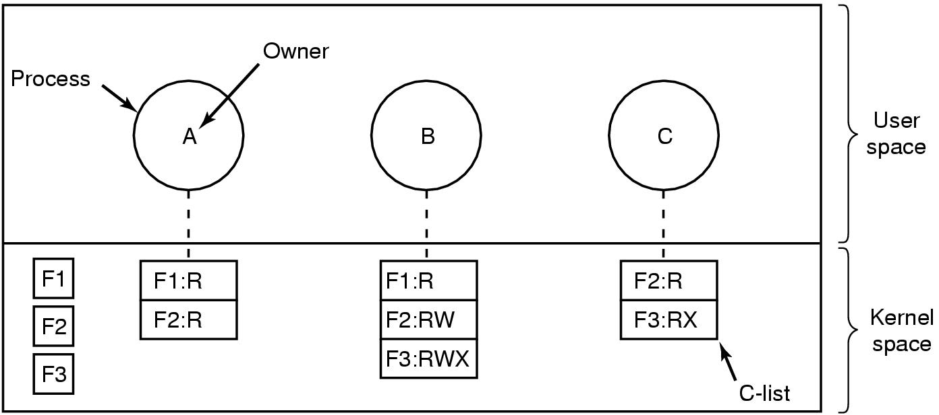
Capabilities 权能字(1)
按行存放
Each process has a capability list(全能字表）

Slide 35
Capabilities (2)
为防止篡改，已有三种保护方法：
  建立带标记的体系结构、在OS里保存权能字表、将权能字表放在用户空间里，并用加密方法进行管理。
Cryptographically-protected capability(采用密码保护的权能字)
Generic Rights
  Copy capability(复制权能字) 2.Copy object
  Remove capability 3.Destroy object
  附：权能字有选择性撤回对对象的的访问十分困难。
  ACL较为常见，在Windows和UNIX系统；
  全能字在Android等系统
Server | Object | Rights | f(Objects, Rights, Check)

Slide 36
Content of this lecture
The security environment
Operating system security（操作系统安全）
Protection mechanisms (保护机制)
Formal Models of Secure Systems
Basics of cryptography (密码学基础)
User authentication (用户验证)
Software vulnerabilities(软件漏洞）
Attacks from inside the system(内部攻击)
Malware(恶意软件)
Defense（防御）
Summary

Slide 37
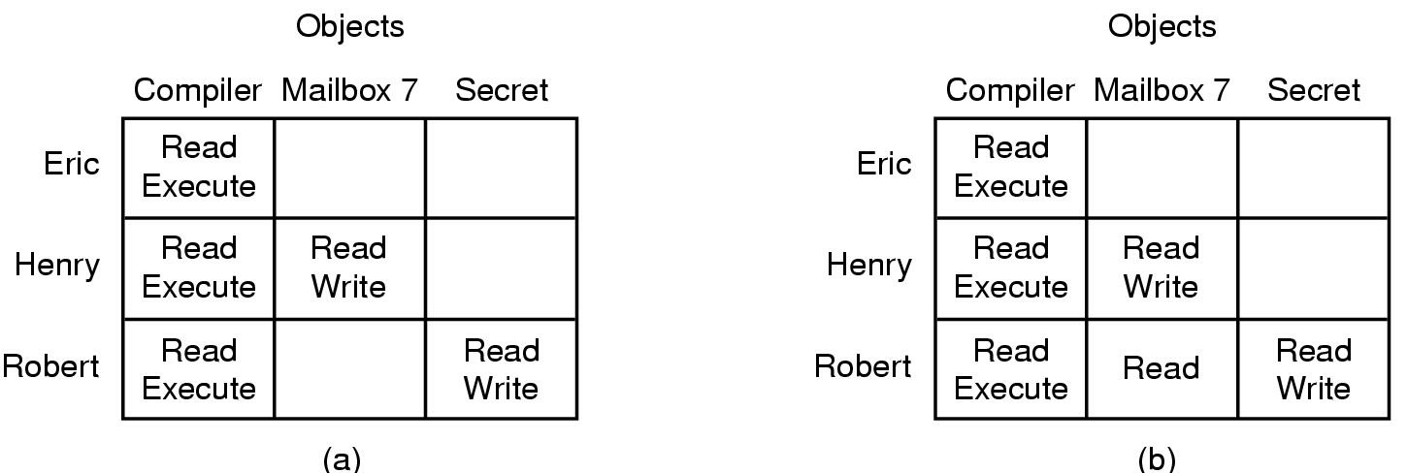
Formal Models of Secure Systems
—保护矩阵
An authorized state (b) An unauthorized state
Robert发出命令将（a)改为(b)
保护矩阵的6种最基本的操作（可作为保护命令），可作为任何安全系统模型的基准。
所有可能的矩阵被划分为两个独立的集合：所有处于授权状态的集合和所有未授权的集合

Slide 38
Multilevel Security (1)
可自主支配的访问控制（Discretionary Access Control，DAC）：大多数操作系统允许个人用户决定谁可以读写他们的文件与其他对象。如传统UNIX。
强制性的访问控制（Mandatory Access Control，MAC）：机构定义了谁可以看什么的规则，不允许所有者来改变，确保信息不泄露。如Selinux，采用DAC+MAC。

Slide 39
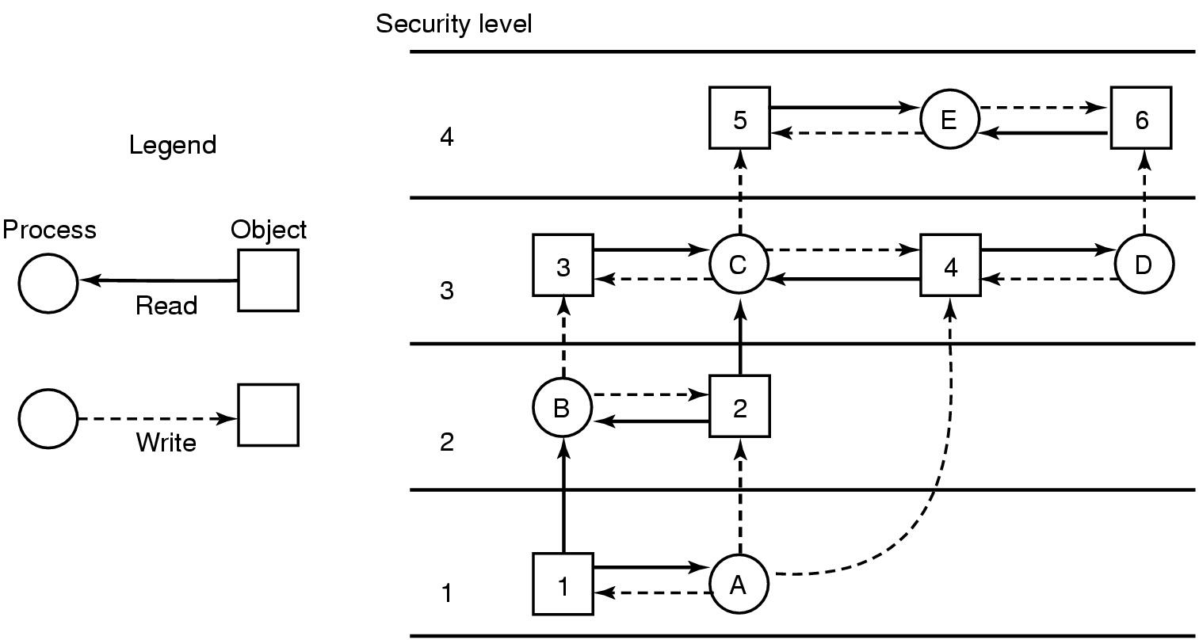






Multilevel Security (2)
The Bell-La Padula multilevel security model(保持机密性的模型)-最广泛使用的。

Slide 40
The Bell-La Padula Model (3)
Rules for the Bell-La Padula model:
The simple security property: A process running at security level k can read only objects at its level or lower. （下读）
The * property: A process running at security level k can write only objects at its level or higher. （上写）
军方应用
OS应用可对每个用户分配一个安全级别，该安全级别与用户认证信息（UID、GID）一起存储。用户登录时，shell获得用户的安全级别，且该安全级别被shell创建的所有子进程继承下去。

Slide 41
The Biba Model
保持完整性的模型
Rules for the Biba model:
The simple integrity principle: A process running at security level k can write only objects at its level or lower (no write up).（下写）
The integrity * property: A process running at security level k can read only objects at its level or higher (no read down).（上读）

Slide 42
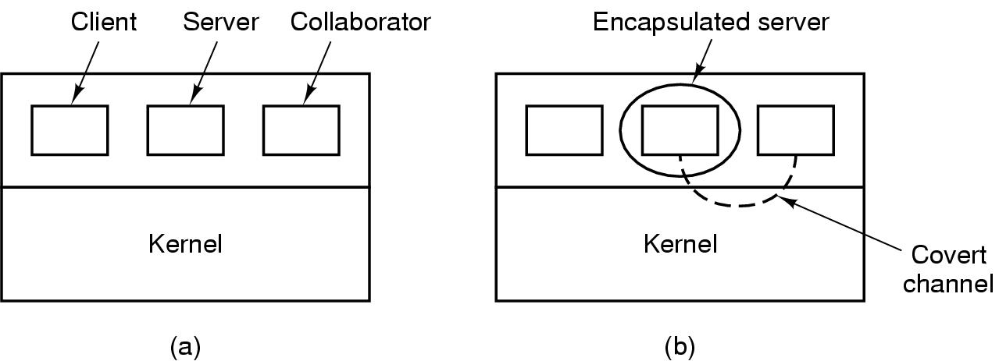
Covert Channels隐蔽信道(1)
Figure 9-14. (a) The client, server, and collaborator processes. (b) The encapsulated server can still leak to the collaborator via covert channels.
调整CPU的使用率不是唯一的隐蔽信道，还可调制页率（多个页面错误表示1，没有页面错误表示0）。一个计时方式里，几乎任何可以降低系统性能的途径都可以是隐蔽信道的候选。

Slide 43
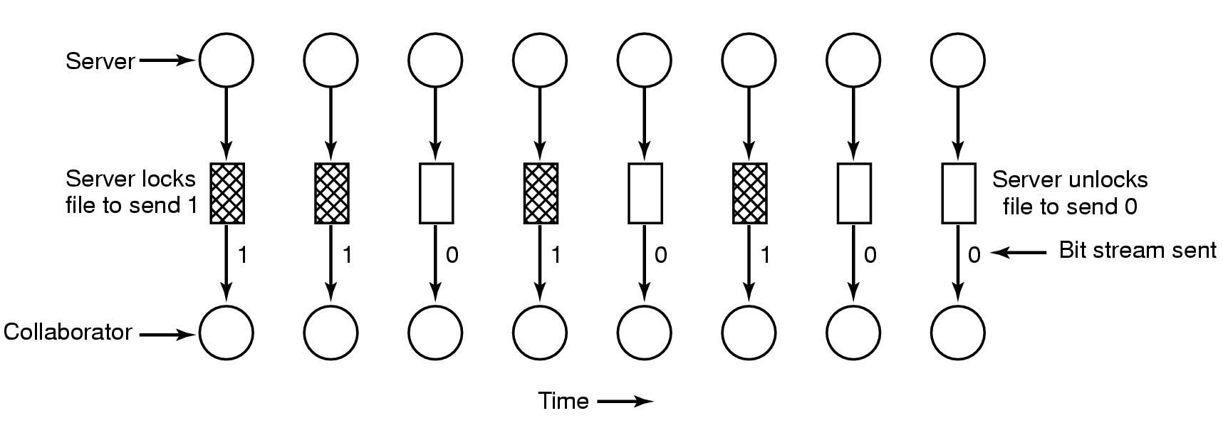
Covert Channels (2)
Figure 9-15. A covert channel using file locking.
服务器锁定文件发送1，服务器解锁文件发送0

Slide 44
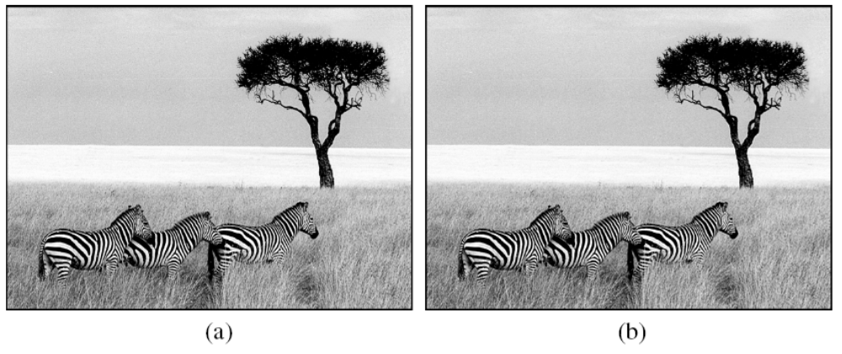
Covert Channels (3)-----隐写术
Figure 9-16. (a) Three zebras and a tree. (b) Three zebras, a tree, and the complete text of five plays by William Shakespeare.

Slide 45
Content of this lecture
The security environment
Operating system security（操作系统安全）
Protection mechanisms (保护机制)
Formal Models of Secure Systems
Basics of cryptography (密码学基础)
User authentication (用户验证)
Software vulnerabilities(软件漏洞）
Attacks from inside the system(内部攻击)
Malware(恶意软件)
Defense（防御）
Summary

Slide 46
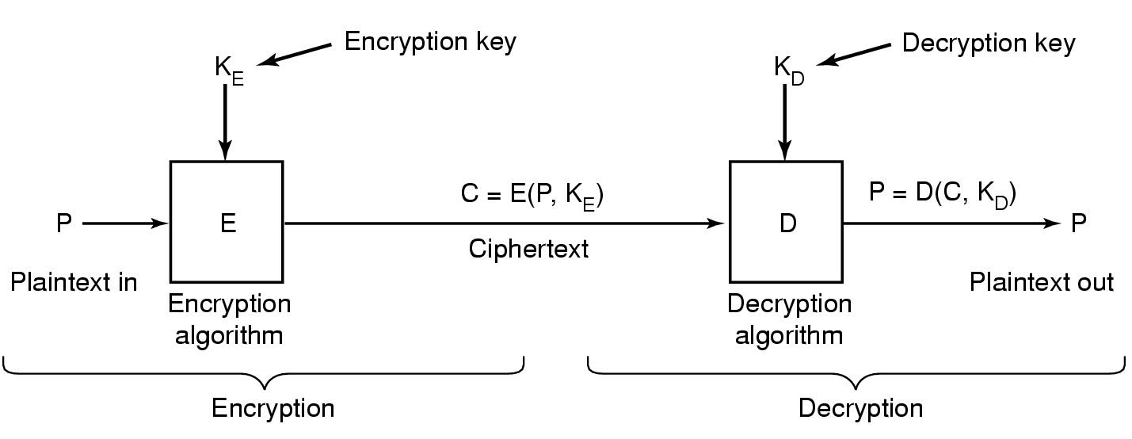
Basics of Cryptography(密码学基础)
加密秘钥
解密秘钥
密文
加密
解密
Relationship between the plaintext(明文) and the ciphertext(密文)

Slide 47
Secret-Key Cryptography(私钥加密或对称密钥加密)
Monoalphabetic substitution(单字母替换)
  each letter replaced by different letter
Given the encryption key,
  easy to find decryption key
Secret-key crypto called symmetric-key crypto(私钥加密技术称为对称密钥加密：给定加密秘钥就能较为容易找到解密秘钥. A与 B 之间之间的通讯数据都用同一套的密钥来进行加密解密。
对称加密通常有:DES,IDEA,3DES 加密算法

Slide 48
Public-Key Cryptography(公钥加密技术或非对称加密
All users pick a public key/private key pair
  publish the public key
  private key not published
Public key is the encryption key(加密秘钥)
  private key is the decryption key(解密秘钥)
加密秘钥和解密秘钥是不同的，并且给出加密秘钥后不可能推出对应的解密秘钥
用公钥和私钥来加解密的算法。A 的公钥加密过的东西只能通过 A 的私钥来解密；同理，A 的私钥加密过的东西只能通过 A 的公钥来解密。

Slide 49
Basics of Cryptography -- One-Way Functions(单向函数)
Function such that given formula for f(x)
  easy to evaluate y = f(x)
But given y
  computationally infeasible to find x

Slide 50
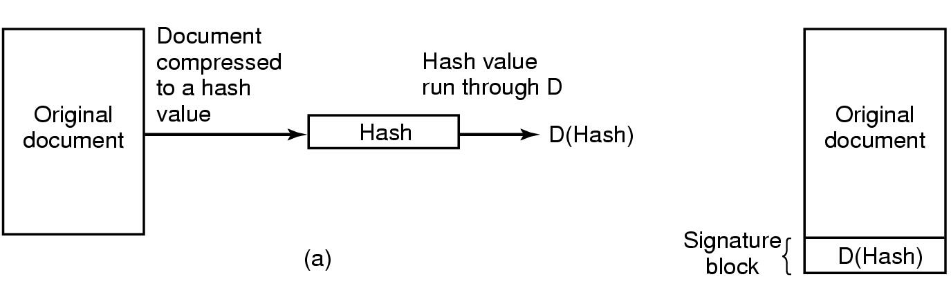
Digital Signatures(数字签名——用来保证信息传输的完整性、发送者的身份认证、防止交易中的抵赖发生)
文档压缩后得到散列值
散列值
对散列值运算得到D(散列值）
(b)
a.Computing a signature block
  对文档运行一单向散列运算（hashing）,这种运算几乎不可逆；文件所有者利用他的私密对散列值进行运算得到D(散列值），该值称为签名块，被附加在文档后传给接受方
b.What the receiver gets
  接受方收到文档和散列值时,先计算文档的散列值,然后接受方使用发送方的公钥对签名块进行运算以得到E(D(hash),如果计算后散列值与签名块中的散列值不一致,则表明文档或签名块或两者被篡改.
数字证书（用户姓名、公钥、可信第三方数字签名）。认证机构CA作为可信的第三方提供签名证书。采用PKI公钥基础设施管理公钥。

Slide 51
Content of this lecture
The security environment
Operating system security（操作系统安全）
Protection mechanisms (保护机制)
Formal Models of Secure Systems
Basics of cryptography (密码学基础)
User authentication (用户验证)
Software vulnerabilities(软件漏洞）
Attacks from inside the system(内部攻击)
Malware(恶意软件)
Defense（防御）
Summary

Slide 52
User Authentication（用户验证）
Basic Principles. Authentication must identify:
Something the user knows
Something the user has
Something the user is
This is done before user can use the system

Slide 53
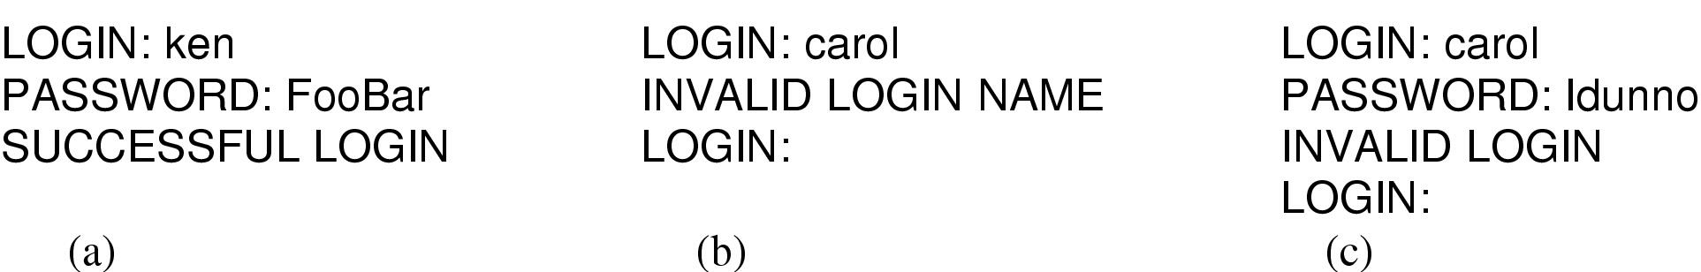
Authentication Using Passwords
(a) A successful login
(b) Login rejected after name entered
(c) Login rejected after name and password typed

Slide 54
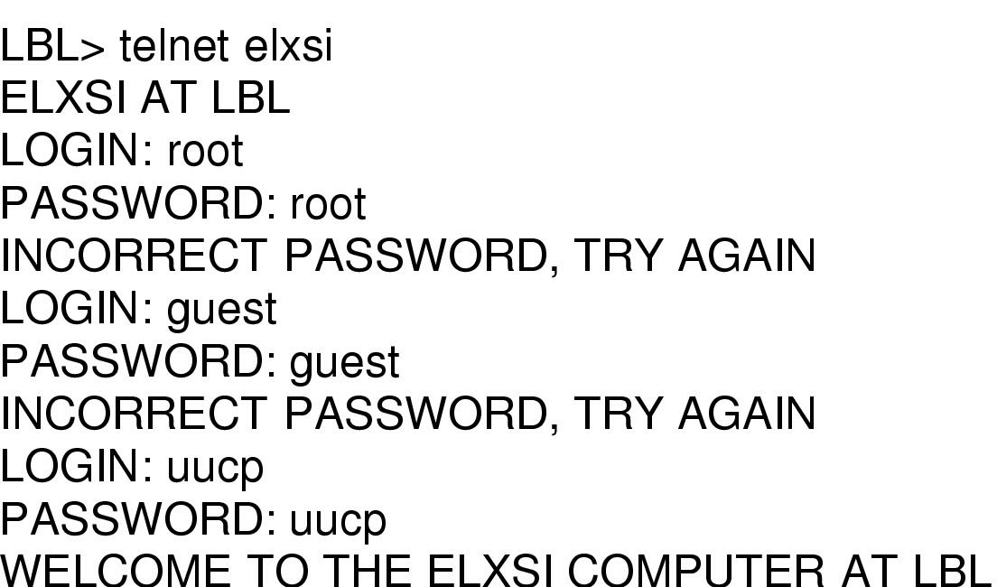
Authentication Using Passwords
-How a cracker(骇客 broke into LBL
How a cracker(骇客 broke into LBL ( Lawrence Berkeley Lab)
  a U.S. Dept. of Energy research lab(美国能源部研究实验室)

Slide 55
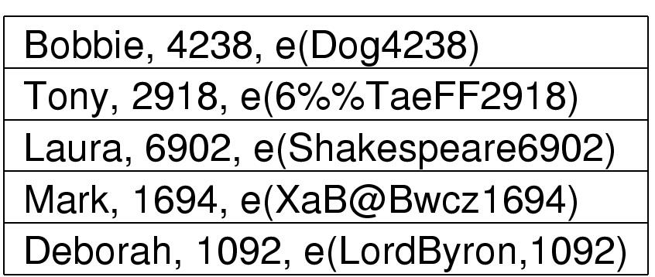
Authentication Using Passwords
--Unix Password Security
,
,
,
,
Salt
Password
The use of salt(是一随机数) to defeat precomputation of encrypted passwords

Slide 56
Authentication Using Passwords
Improving Password Security
  Passwords should be a minimum of seven characters
  Passwords should contain both upper and lower case letter
  Passwords should contain at least one digit or special character
  Passwords should not be dictionary words, people’s name, etc.
-One-Time Passwords
-Challenge-Response Authentication (挑战-响应验证)
,
,
,
,

Slide 57
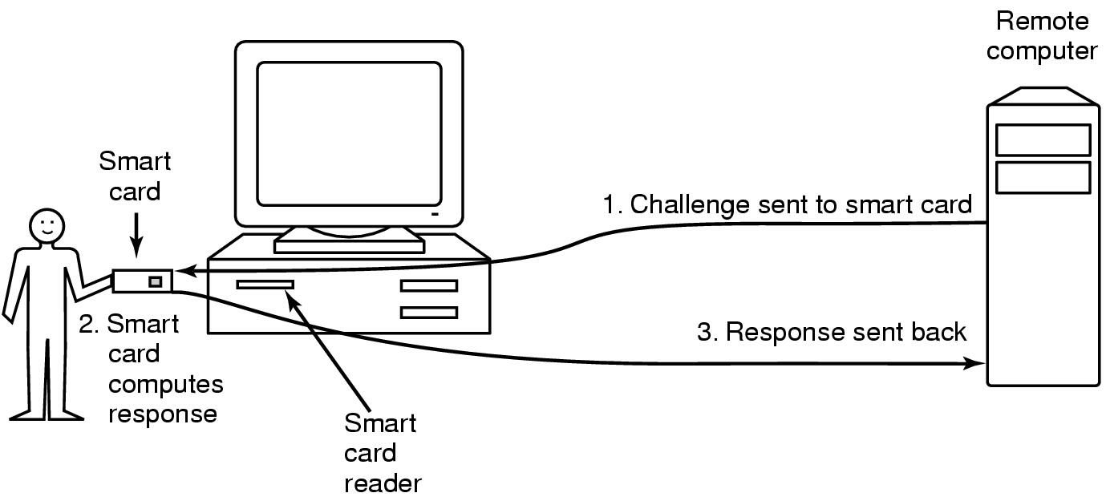
Authentication Using a Physical Object
--Smart Card
Magnetic cards
  magnetic stripe cards
  chip cards: stored value cards, smart cards

Slide 58
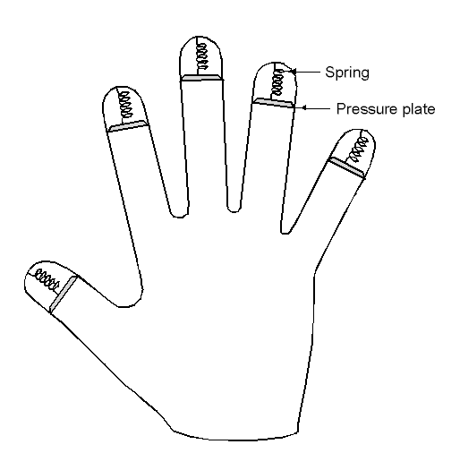
Authentication Using Biometrics
A device for measuring finger length.

Slide 59
Authentication
--Countermeasures(对策)
Limiting times when someone can log in
Automatic callback at number prespecified
Limited number of login tries
A database of all logins
Simple login name/password as a trap
  security personnel notified when attacker bites

Slide 60
Content of this lecture
The security environment
Operating system security（操作系统安全）
Protection mechanisms (保护机制)
Formal Models of Secure Systems
Basics of cryptography (密码学基础)
User authentication (用户验证)
Software vulnerabilities(软件漏洞）
Attacks from inside the system(内部攻击)
Malware(恶意软件)
Defense（防御）
Summary

Slide 61
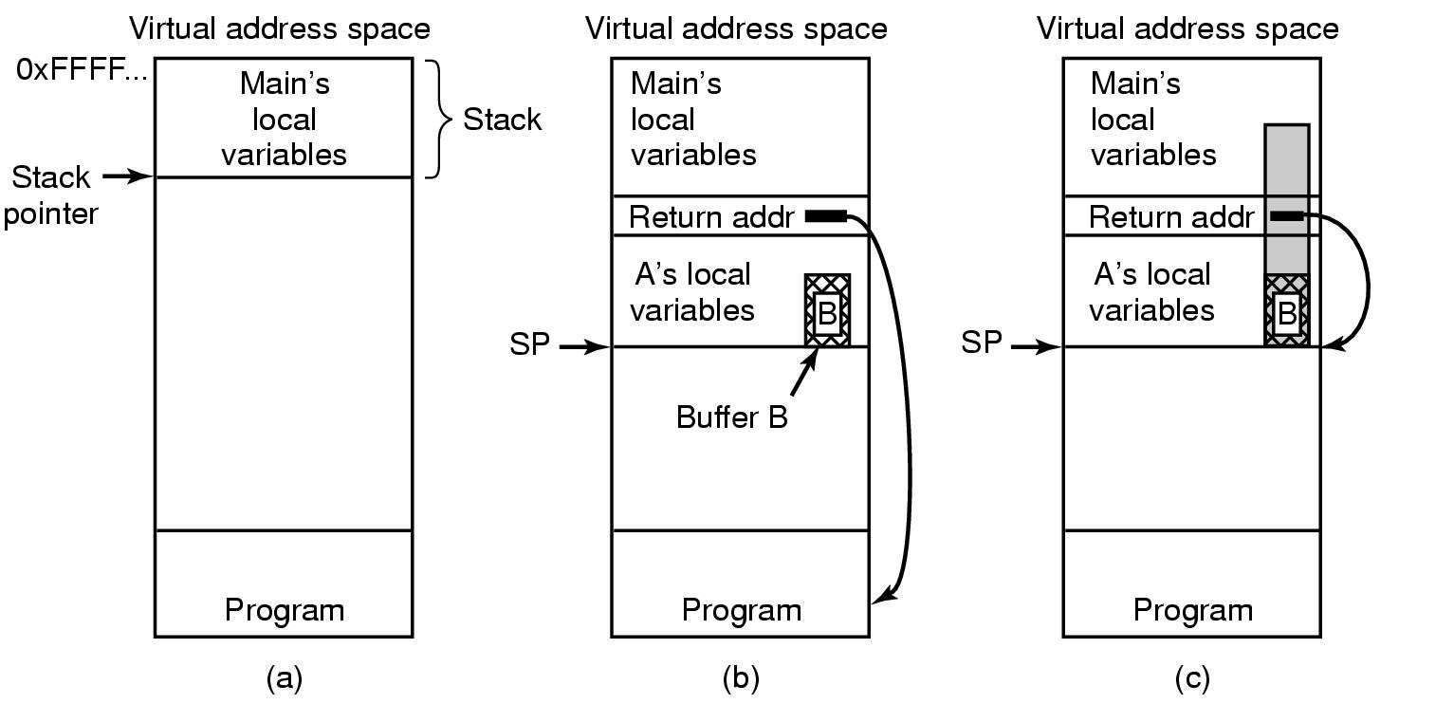
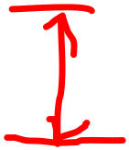

Buffer Overflow
(a) Situation when main program is running
(b) After program A called
(c) Buffer overflow shown in gray

Slide 62
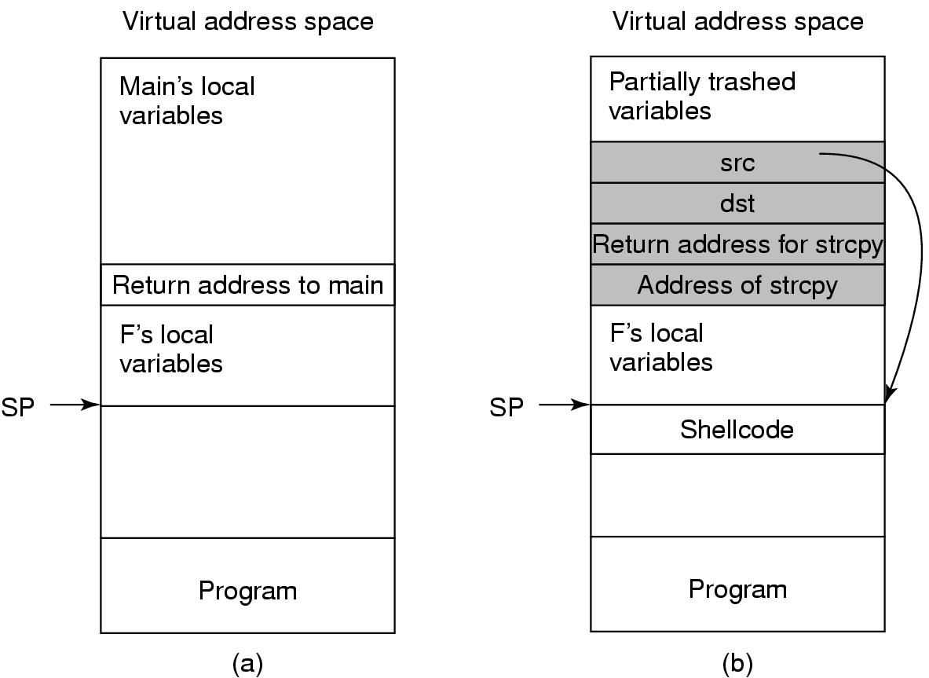
Return to libc Attacks
Figure 9-25. (a) The stack before the attack.
(b) The stack after the stack has been overwritten.
Tanenbaum, Modern Operating Systems 3 e, (c) 2008 Prentice-Hall, Inc. All rights reserved. 0-13-6006639

Slide 63
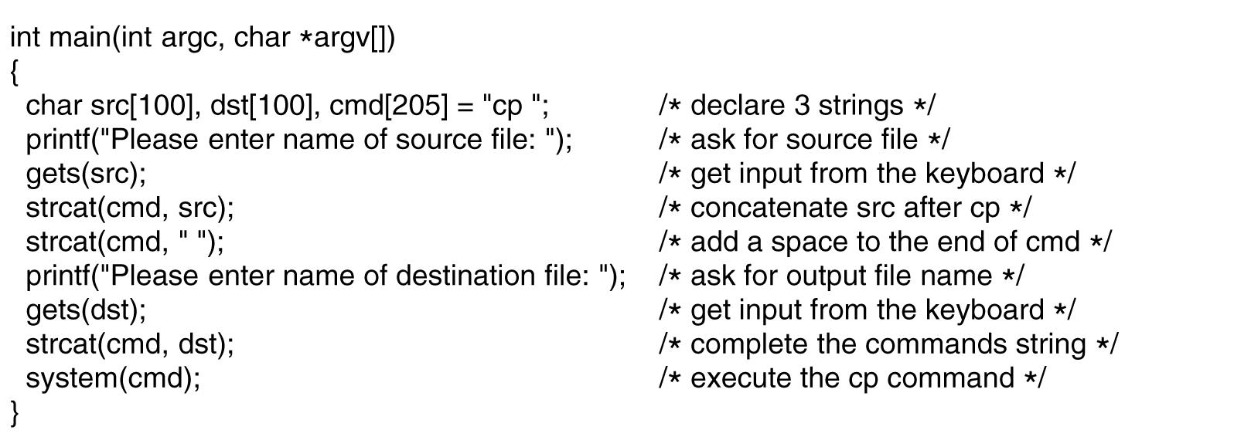
Code Injection Attacks
Figure 9-25. Code that might lead to a code injection attack.
Tanenbaum, Modern Operating Systems 3 e, (c) 2008 Prentice-Hall, Inc. All rights reserved. 0-13-6006639

Slide 64
Types of Viruses
Companion virus
Executable program virus
Parasitic virus
Memory-resident virus
Boot sector virus
Device driver virus
Macro virus
Source code virus
Tanenbaum, Modern Operating Systems 3 e, (c) 2008 Prentice-Hall, Inc. All rights reserved. 0-13-6006639

Slide 65
Content of this lecture
The security environment
Operating system security（操作系统安全）
Protection mechanisms (保护机制)
Formal Models of Secure Systems
Basics of cryptography (密码学基础)
User authentication (用户验证)
Software vulnerabilities(软件漏洞）
Attacks from inside the system(内部攻击)
Malware(恶意软件)
Defense（防御）
Summary

Slide 66
Logic Bombs(逻辑炸弹)
Company programmer writes program
  potential to do harm
  OK as long as he/she enters password daily
  If programmer fired, no password and bomb explodes

Slide 67
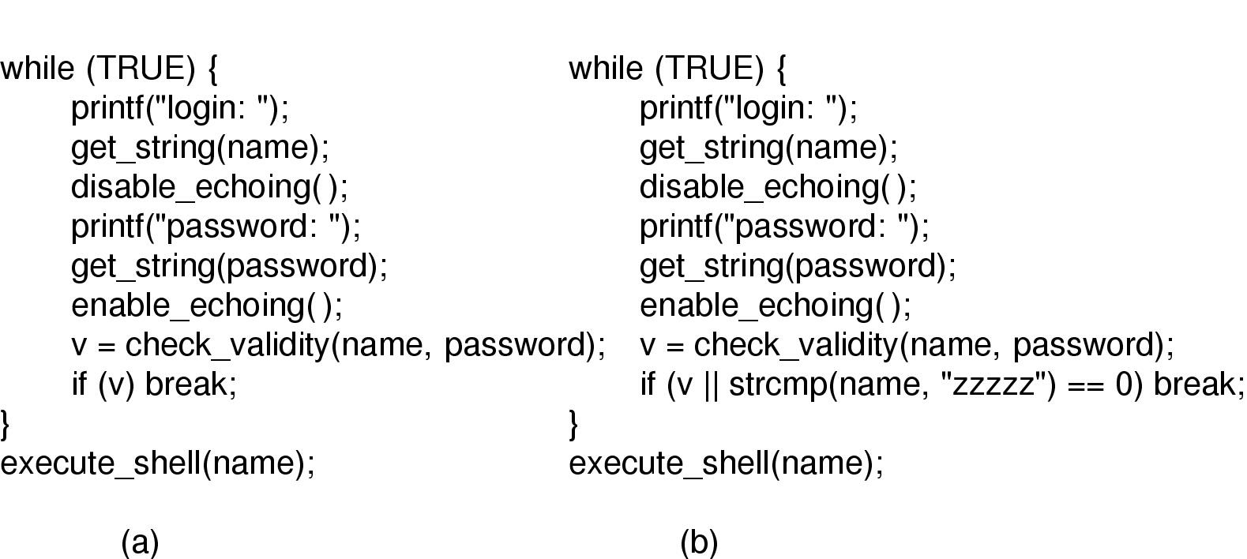
Trap Doors(后门陷阱)
(a) Normal code.
(b) Code with a trapdoor inserted

Slide 68
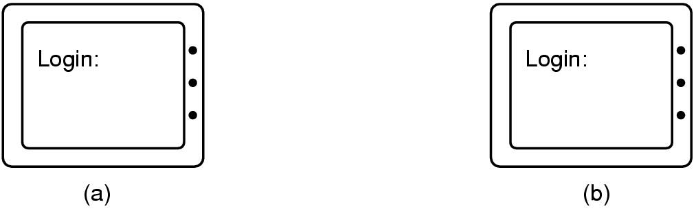
Login Spoofing(登录欺骗)
(a) Correct login screen
(b) Phony login screen(假冒登录屏幕)
在windows 可用CTRL+ALT+DEL避免

Slide 69
Exploiting Code Bugs
Example steps to exploit a bug:
Run port scan to find machines that accept telnet connections.
Try to log in by guessing login name and password combinations.
Once in, run the flawed program with input that triggers the bug.
If the buggy program is SETUID root, create a SETUID root shell.
Fetch and start a zombie program that listens to an IP port for cmds.
Arrange that the zombie program is started when the system reboots.

Slide 70
Content of this lecture
The security environment
Operating system security（操作系统安全）
Protection mechanisms (保护机制)
Formal Models of Secure Systems
Basics of cryptography (密码学基础)
User authentication (用户验证)
Software vulnerabilities(软件漏洞）
Attacks from inside the system(内部攻击)
Malware(恶意软件)
Defense（防御）
Summary

Slide 71
Trojan Horses(特骆伊木马)
Free program made available to unsuspecting user
  Actually contains code to do harm
  免费软件（内嵌入恶意代码）
Place altered version of utility program on victim's computer
  trick user into running that program

Slide 72
Network Security
External threat
  code transmitted to target machine
  code executed there, doing damage
Goals of virus writer
  quickly spreading virus
  difficult to detect
  hard to get rid of
Virus = program can reproduce itself
  attach its code to another program
  additionally, do harm

Slide 73
Virus Damage Scenarios(病毒破坏的场景)
Blackmail
Denial of service as long as virus runs(拒绝服务)
Permanently damage hardware(永久损害硬件)
Target a competitor‘s computer(目标为竞争者的计算机)
  do harm
  espionage
Intra-corporate dirty tricks
  sabotage another corporate officer‘s files(暗中破坏)

Slide 74
How Viruses Work (1)
Virus written in assembly （or C）language
Inserted into another program
  use tool called a “dropper”
Virus dormant until program executed
  then infects other programs
  eventually executes its “payload”

Slide 75
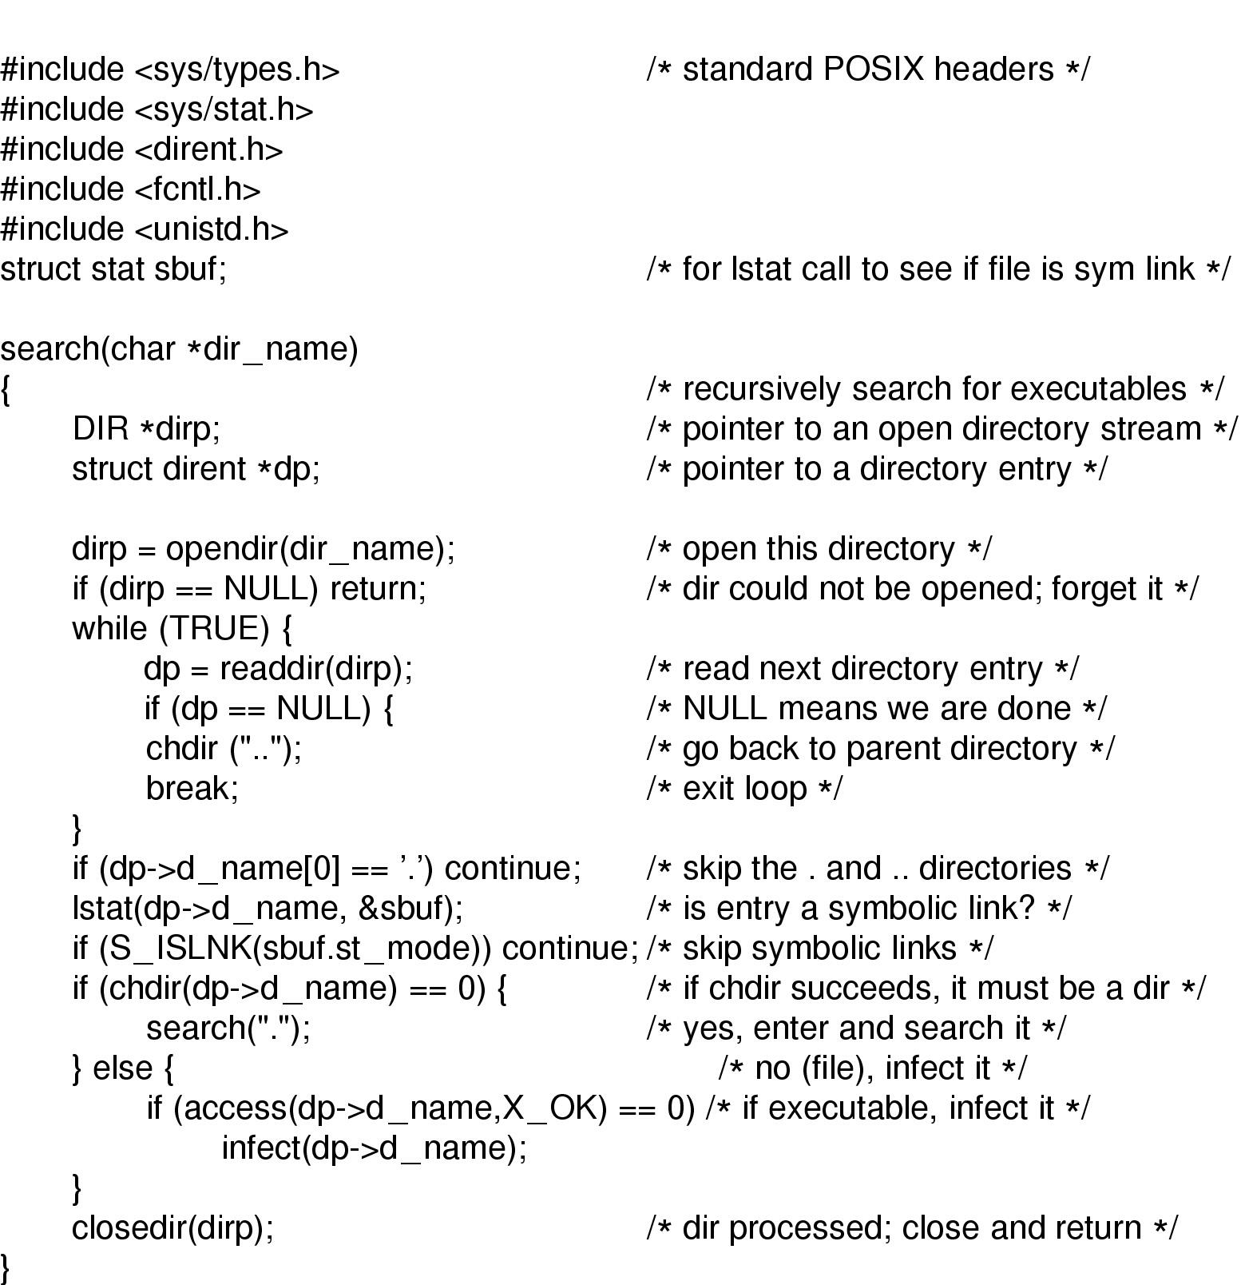

How Viruses Work --- executable program Viruses
病毒覆盖可执行程序
Recursive procedure that finds executable files on a UNIX system
Virus could
infect them all

Slide 76
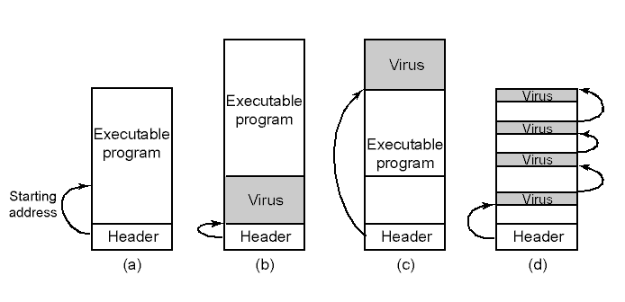
How Viruses Work –parasitic virus(寄生虫病毒)
An executable program
With a virus at the front
With the virus at the end
With a virus spread over free space within program

Slide 77
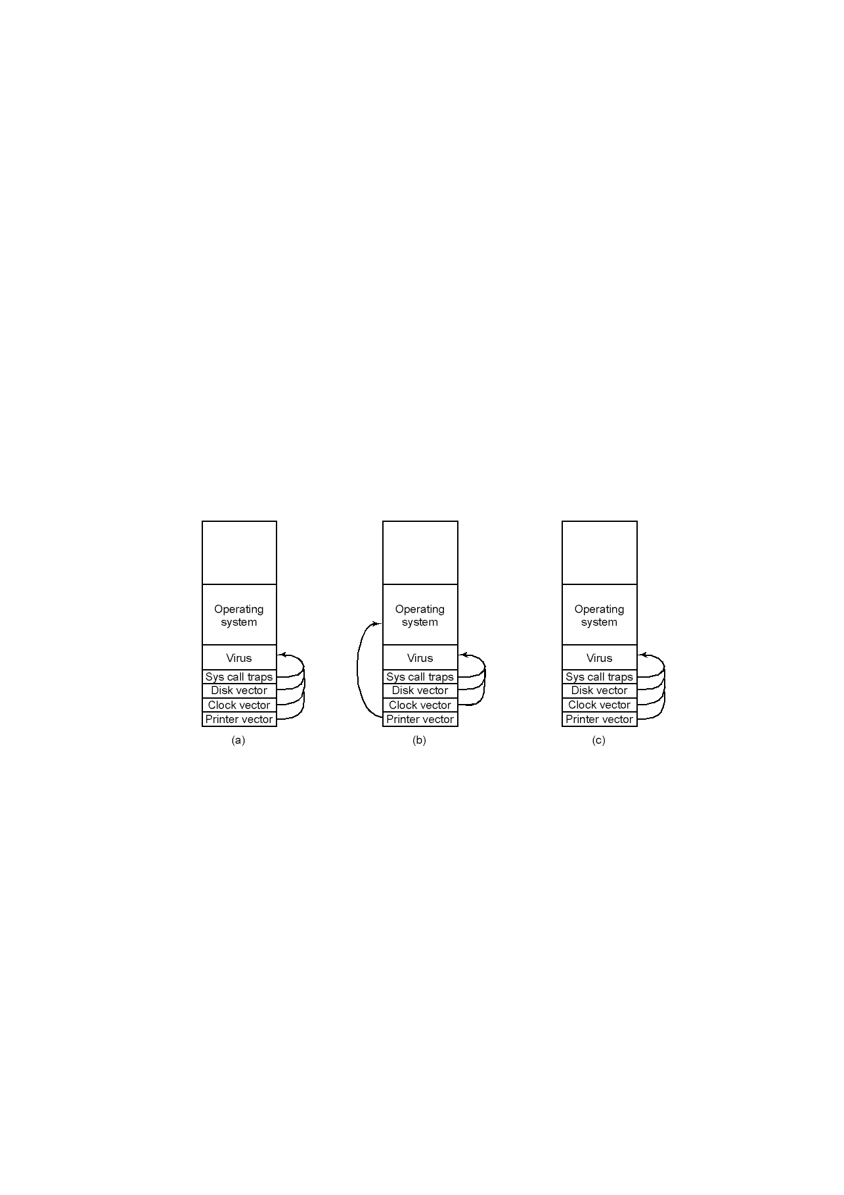
How Viruses Work –Boot Sector Virus
After virus has captured interrupt, trap vectors
After OS has retaken printer interrupt vector
After virus has noticed loss of printer interrupt vector and recaptured it

Slide 78
How Viruses Spread
Virus placed where likely to be copied
When copied
  infects programs on hard drive, floppy
  may try to spread over LAN
Attach to innocent looking email
  when it runs, use mailing list to replicate

Slide 79
The Internet Worm(蠕虫)
Consisted of two programs(蠕虫包含两部分)
  bootstrap to upload worm
  the worm itself
Worm first hid its existence
Next replicated itself on new machines

Slide 80
Content of this lecture
The security environment
Operating system security（操作系统安全）
Protection mechanisms (保护机制)
Formal Models of Secure Systems
Basics of cryptography (密码学基础)
User authentication (用户验证)
Software vulnerabilities(软件漏洞）
Attacks from inside the system(内部攻击)
Malware(恶意软件)
Defense（防御）
Summary

Slide 81
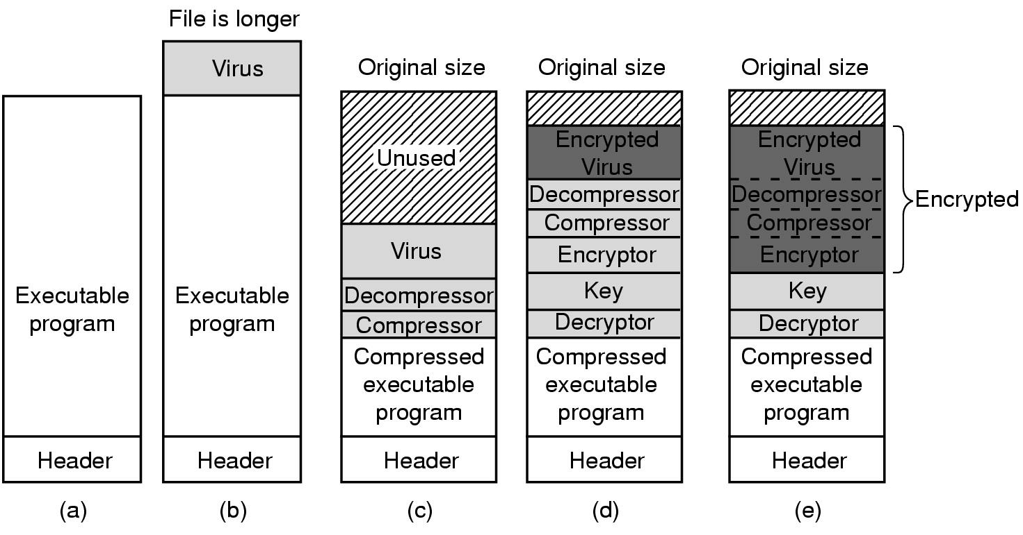
Antivirus and Anti-Antivirus Techniques—
Virus Scanners(1)
(a) A program
(b) Infected program
(c) Compressed infected program
(d) Encrypted virus
(e) Compressed virus with encrypted compression code

Slide 82
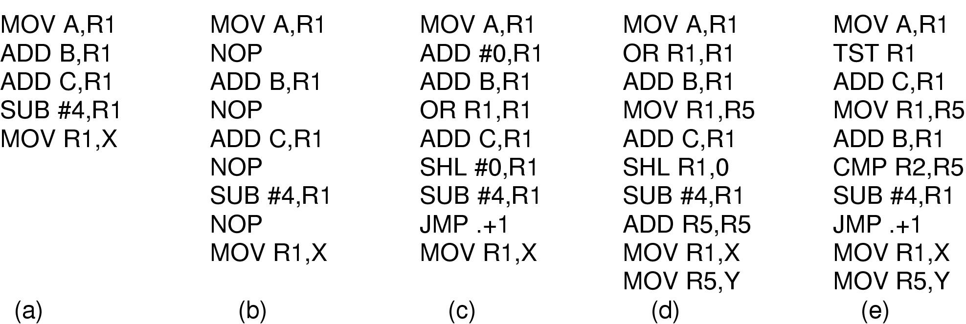
Antivirus and Anti-Antivirus Techniques
-- Virus Scanners(2)
Examples of a polymorphic virus
All of these examples do the same thing

Slide 83
Antivirus and Anti-Antivirus Techniques
-others methds
Integrity checkers(完整性检查)
Behavioral checkers(行为检查)
Virus avoidance
  good OS
  install only shrink-wrapped software
  use antivirus software
  do not click on attachments to email
  frequent backups
Recovery from virus attack
  halt computer, reboot from safe disk, run antivirus

Slide 84
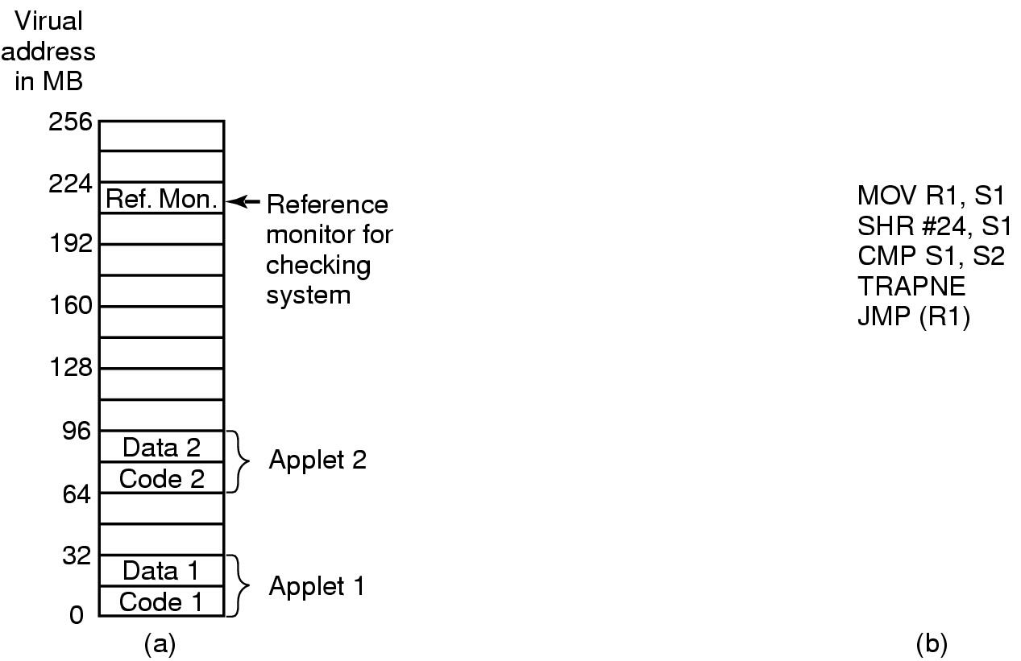
Mobile Code (1) 对付移动代码的三种方法
-Sandboxing(沙盒法)
(a) Memory divided into 1-MB sandboxes
(b) One way of checking an instruction for validity

Slide 85
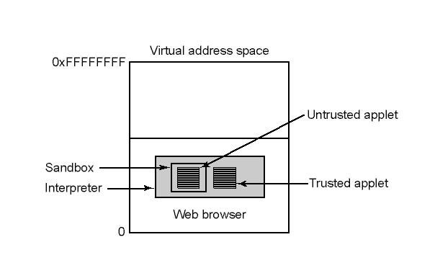
Mobile Code (1) 对付移动代码的三种方法
--Interpretation(解释法)
Applets can be interpreted by a Web browser

Slide 86
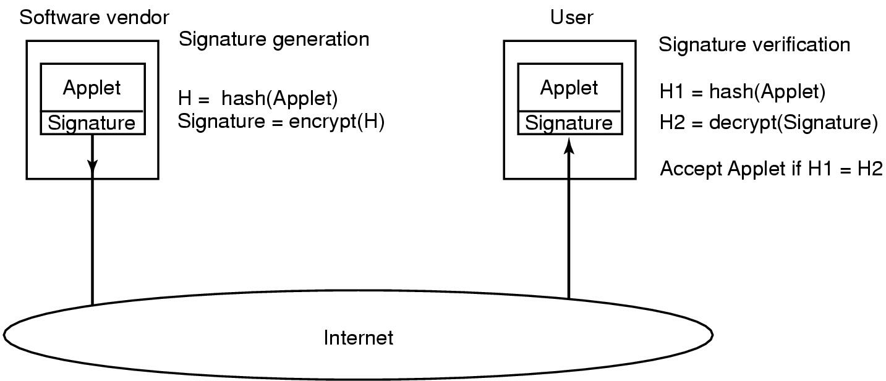
Mobile Code (1) 对付移动代码的三种方法----Code(代码签名法)
How code signing works

Slide 87
Java Security (1)
A type safe language
  compiler rejects attempts to misuse variable
Checks include …
  Attempts to forge pointers(是否伪造指针)
  Violation of access restrictions on private class members(是否违背私有成员的访问限制)
  Misuse of variables by type(乱用变量类型)
  Generation of stack over/underflows(是否栈上溢或下溢)
  Illegal conversion of variables to another type非法变量类型转换)

Slide 88
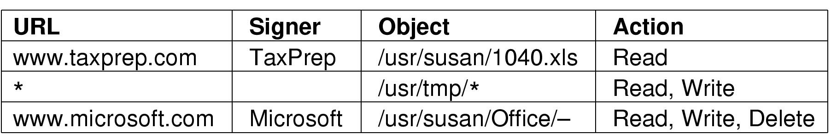
Java Security (2)
Examples of specified protection with JDK 1.2

Slide 89
Design Principles for Security
System design should be public
Default should be no access
Check for current authority
Give each process least privilege possible
Protection mechanism should be
  Simple(简单)
  Uniform(一致)
  in lowest layers of system(深入到系统低层)
Scheme(方案) should be psychologically (心理)acceptable
And … keep it simple

Slide 90
Content of this lecture
The security environment
Operating system security（操作系统安全）
Protection mechanisms (保护机制)
Formal Models of Secure Systems
Basics of cryptography (密码学基础)
User authentication (用户验证)
Software vulnerabilities(软件漏洞）
Attacks from inside the system(内部攻击)
Malware(恶意软件)
Defense（防御）
Summary

Slide 91
可选作业
P399 8,9, 60

